Slide 1
Exercise 1
You are given a file named journal.html and journal_basic.css that represents a page from Victoria's journal. You are to write a stylesheet called journal_layout.css that will transform the layout in different ways throughout the following exercises.
Arrange Your Page into Sections
The first task is to organize journal.html by adding ids, classes, spans and divs. Then, add "boxes" around these sections of the website by adding to your journal_layout.css stylesheet.

Slide 2
Exercise 1 (Cont.)
You are going to match the output below
The borders are all 5px thick and solid.
The colors are the intuitive HTML color names, e.g. the red border is the HTML color red.
Note: You should not need define a class or id specifically for the h2s on this page. Hint: To reduce the amount of id and class attributes you need to set in the XHTML code, consider using CSS context selectors as appropriate.

Slide 3
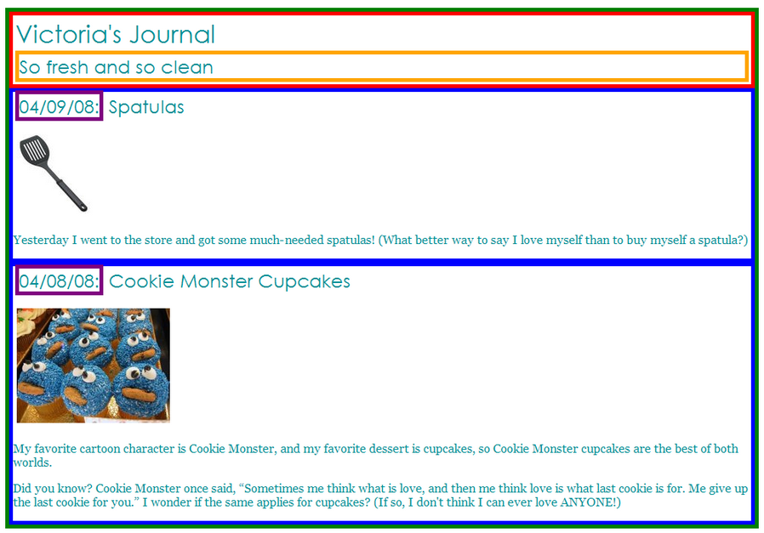

Slide 4

Exercise 1 (Cont.)
Spacing With Padding and Margins, Backgrounds
You are now going to add padding, margins, and backgrounds to some of the parts you defined in question 1. You should only have to change your journal_layout.css file, if you completed Exercise 1 correctly.
The box with the green border should have a background color of white.
The boxes with the blue borders should have a background color of #E8FBFB. It should have a padding of 5px (on all sides) and margin of 10px only on the top of the box (the margins for the remaining sides should be left at 0px).
The overall page content area should become centered on the page, should have left and right margins of 10% and a background image using the following image:

Slide 5
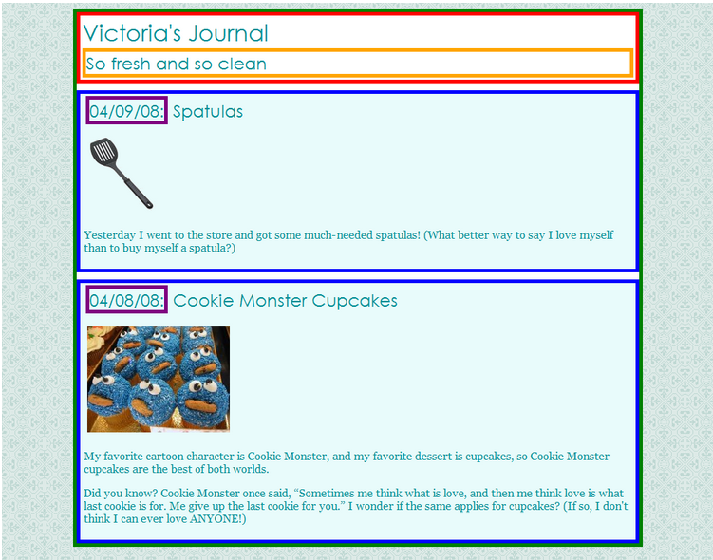

Slide 6
Exercise 1 (Cont.)
Float, Alignment and Clear
You may have to edit your journal.html code as well as your journal_layout.css stylesheet to get the floats working properly.
The heading text in the red box should appear on the right side of that section of the page.
The journal entry images should hover on the right side next to the surrounding text. The image should stay within the bounds of the blue box; that is, it should not bleed into the other content below it.

Slide 7
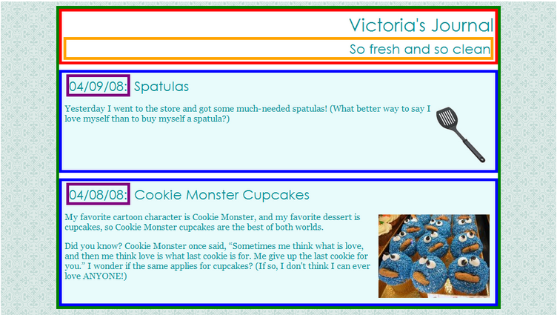

Slide 8
Exercise 1 (Cont.)
Cosmetic Finishing Touches
Finally, we add some finishing touches to make the page look its best.
Change the border of the box with the green border to be a solid, white, 10px-thick border.
Change the border of the boxes with the blue border to have a solid, 4px-thick border, using the hex value #C2E9E9 for its color.
Change the border of the box with the purple border to have only a bottom border, and let that bottom border be blue, dashed, and 2px-thick.
Change the background color of the box with the red border to be #A8F0F0 and get rid of its border altogether.
Change the font size of So fresh and so clean to 14pt and get rid of its border.

Slide 9
